Slide 1

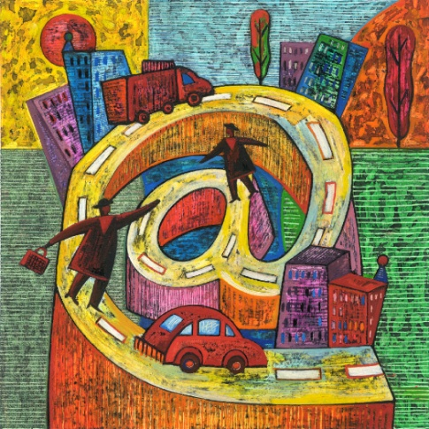
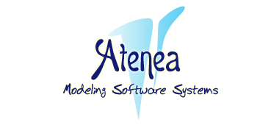

On the Combination of Domain Specific Modeling Languages
Antonio Vallecillo
GISUM/Atenea Research Group
ECMFA, Paris, June 2010
Notes:
ABSTRACT: Domain Specific Modeling Languages (DSMLs) are essential elements in Model-based Engineering. Each DSML allows capturing certain properties of the system, while abstracting other properties away. Nowadays DSMLs are mostly used in silos to solve specific problems. However, there are many occasions when multiple DSMLs need to be combined to design systems in a modular way. In this paper we discuss some scenarios of use and several mechanisms for DSML combination. We propose a general framework for combining DSMLs that subsumes them, based on the concept of viewpoint unification, and its realization using model-driven techniques.

Slide 2
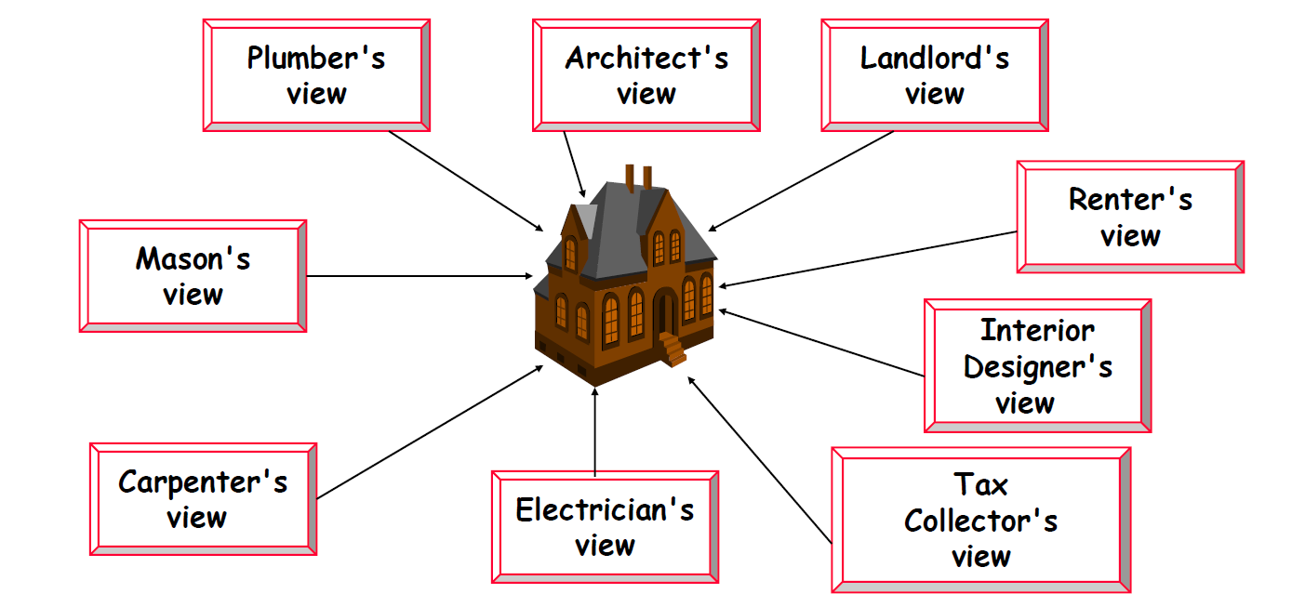
Domain Specific Modeling Languages
A DSML permits describing (and reasoning about) a view of a system using a language close to the domain experts and with the right size and level of abstraction
A system specification is made from many views, each one using its own DSML (vocabulary, rules, notation, style,…)
Yet they need to be related and consistent…
…they all describe the same system!
[Picture borrowed
from J. Bézivin]

Slide 3
Viewpoint specifications
Different stakeholders’ views
End-user
Owner
System
Programmer
Maintainer
Tester
Multiple aspects of a system

Slide 4
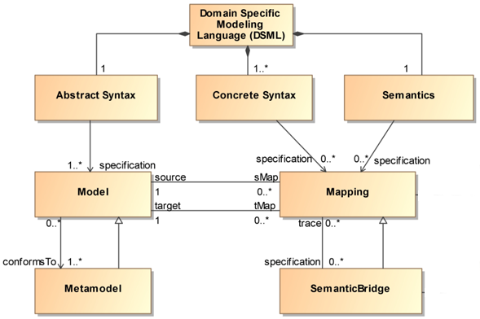
What is (in a) DSML?
[Picture borrowed
from E. Rivera]

Slide 5
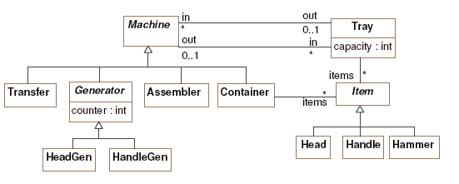
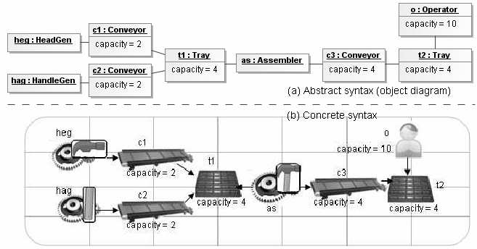
Metamodels and models

Slide 6
Combining DSMLs: Issues to address
How to combine the independent views?
How to build a “combined” language?
Combined Metamodel with the Abstract Syntax?
Combined Concrete Syntax?
Combined Semantics?
How the combined language relates back to the original ones (and to their related tools)?

Slide 7
In this work
We discuss different scenarios of use, and different mechanisms for DSML combination; the advantages they introduce, as well as their limitations
We propose a general proposal for combining DSMLs that subsumes them, based on the concept of unification and its realization using model-driven techniques

Slide 8
Some remarks
The combined (or unified) language might not be “domain specific” any more
It is usually to complex and cumbersome for user consumption and usability (understandability, operability, learnability, attractiveness,…)
Tools should be responsible for constructing it
The user work with the individual views
Tools build the model and extract information from it
[At the end of the day a model is nothing but an artefact built to answer questions about a system under study!]

Slide 9
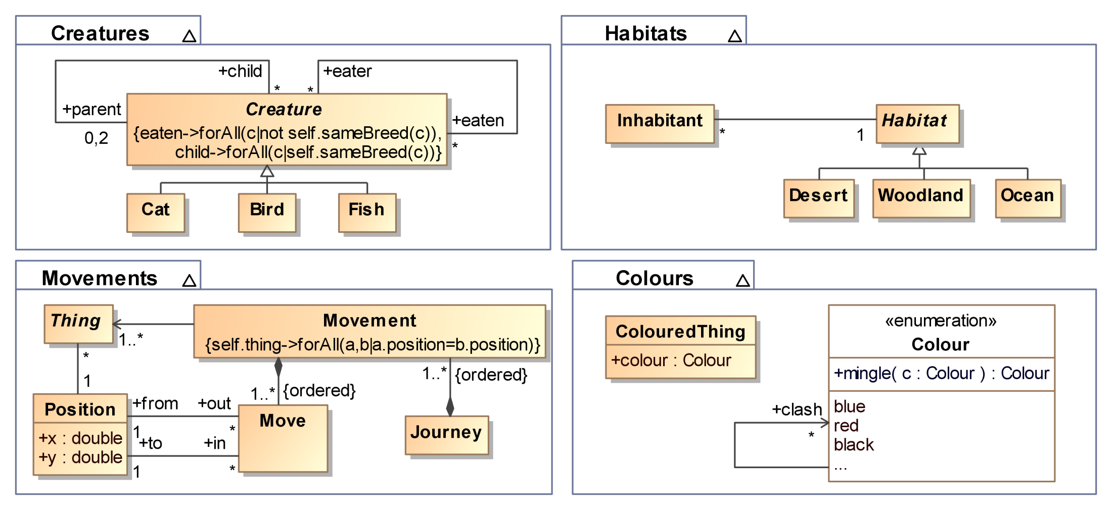
An running example
Adapted from Peter Linington’s “Black cats and coloured birds – What do viewpoint correspondences do?” [WODPEC 2007]
Four viewpoints of a system, each one focusing on a different aspect

Slide 10
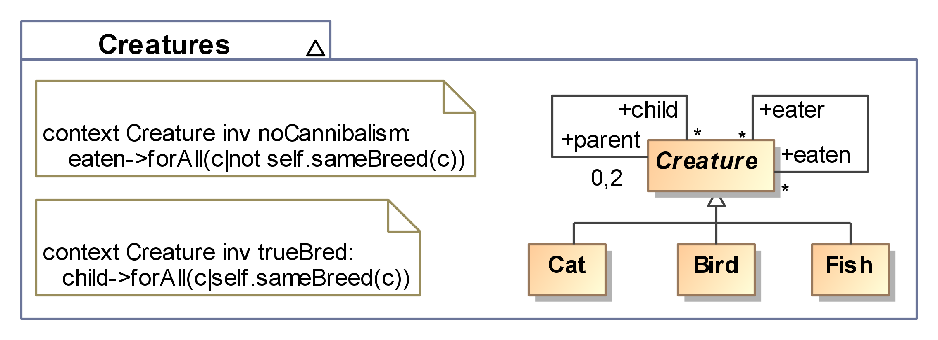
Creatures viewpoint
Various kinds of creatures
They breed true and are not cannibals
[Many thanks to Martin Gogolla for suggesting the OCL expressions for this example]

Slide 11
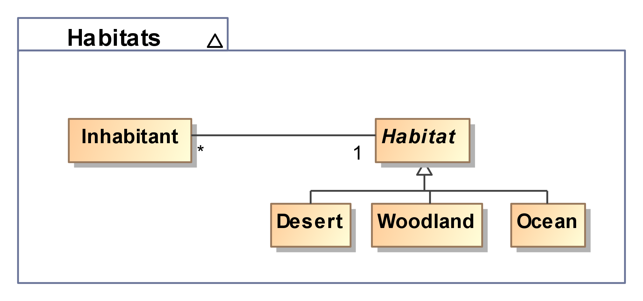
Habitats viewpoint
Inhabitants live in a habitat
There are different kinds of habitats

Slide 12
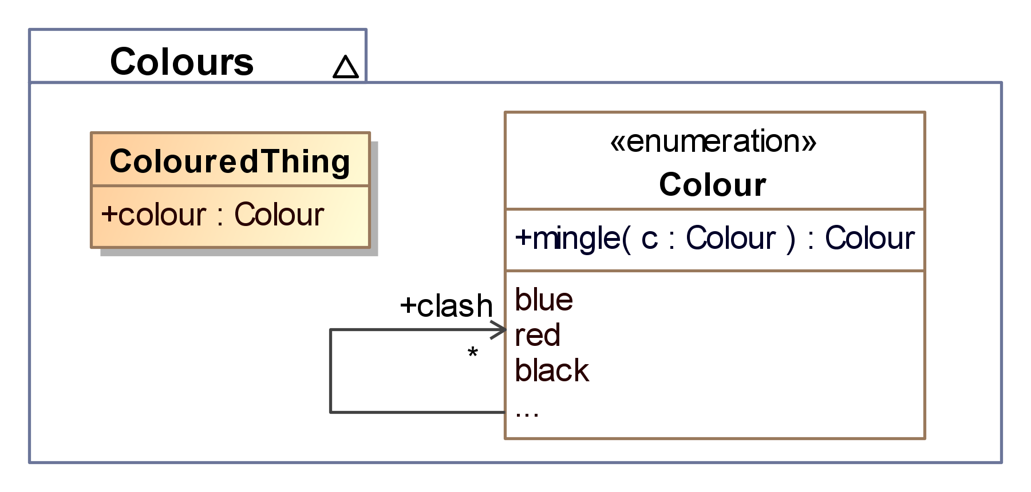
Colours
ColouredThings have a colour
An operation establishes the rule for mingling two Colours
A colour clashes with other strongly contrasted colours

Slide 13
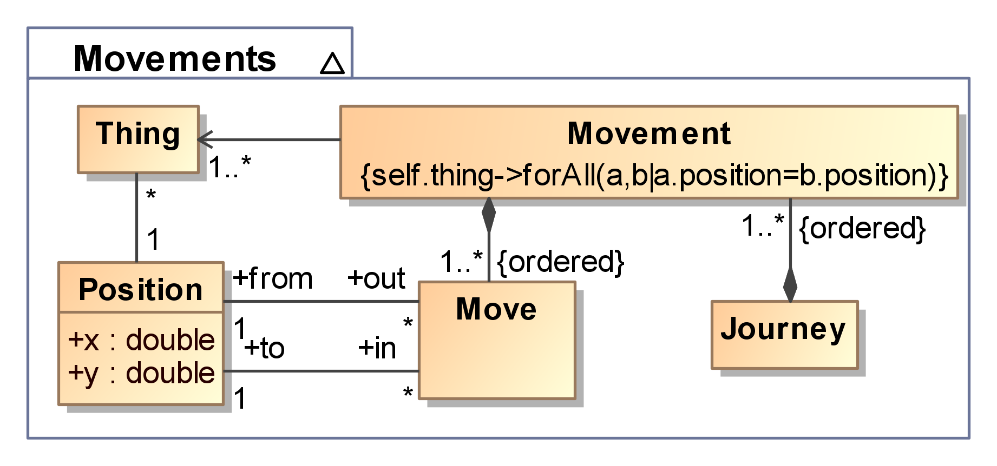
Travelling around
A Position indicates where a Thing is in a moment in time
A Movement transports together a set of things (which are in the same place) from one location to another using a sequence of moves
A Move establishes a valid path between two positions

Slide 14
Three main issues to be addressed
How to relate the elements from the different views?
How to integrate the models of the views into a common workable model?
How to extract information (and other views) from the common model
Viewpoint relation
Synthesis
Analysis

Slide 15
Correspondences
Simple correspondences establish the relationships between elements in different viewpoints
Creatures.Creature <-> Habitats.Inhabitant
Creatures.Creature <-> Colours.ColouredThing
Habitats.Inhabitant <-> Movement.Thing
Habitats.Habitat <-> Colours.ColouredThing
Correspondences do not form part of any viewpoint
Constraints on Correspondences:
We do not want to have red cats or blue woodlands
The colour of an inhabitant cannot clash with the colour of its habitat!

Slide 16
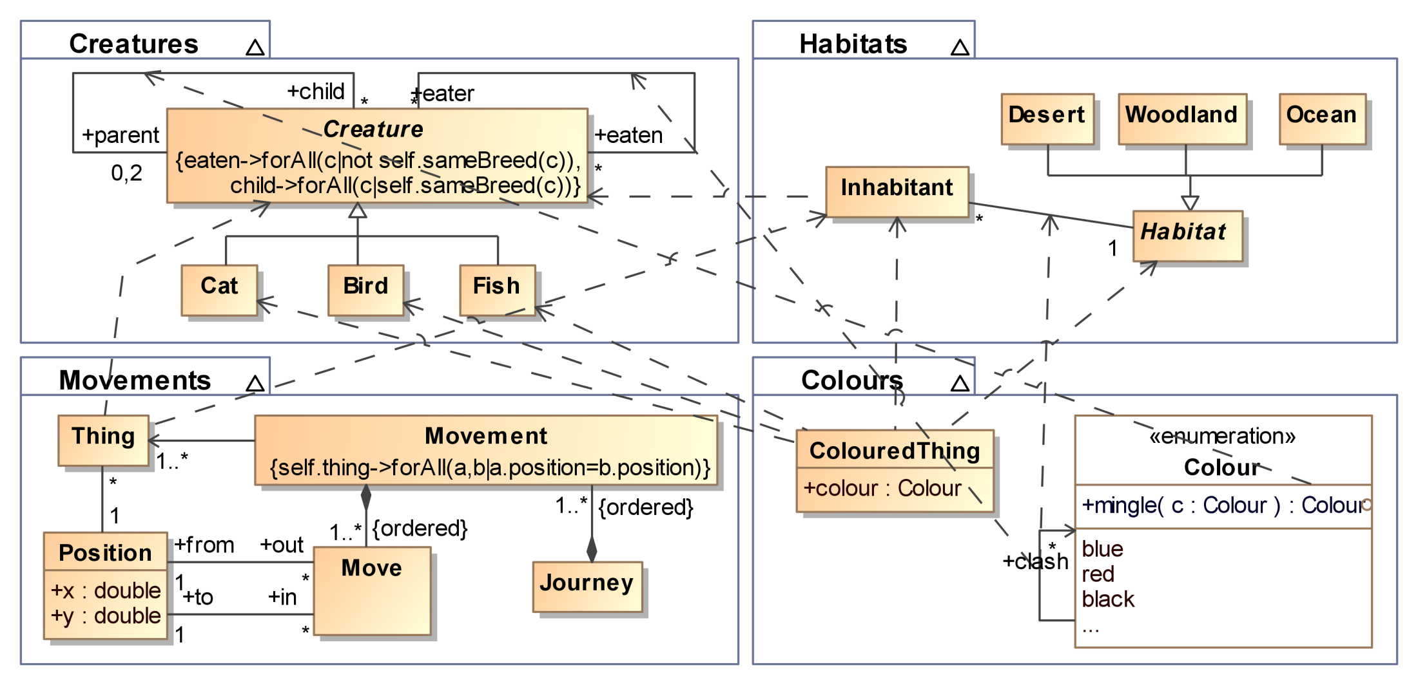
Correspondences

Slide 17
Existing approaches for VP synthesis
Metamodel inheritance
Metamodel extension
Language embedding
Metamodel merge

Slide 18
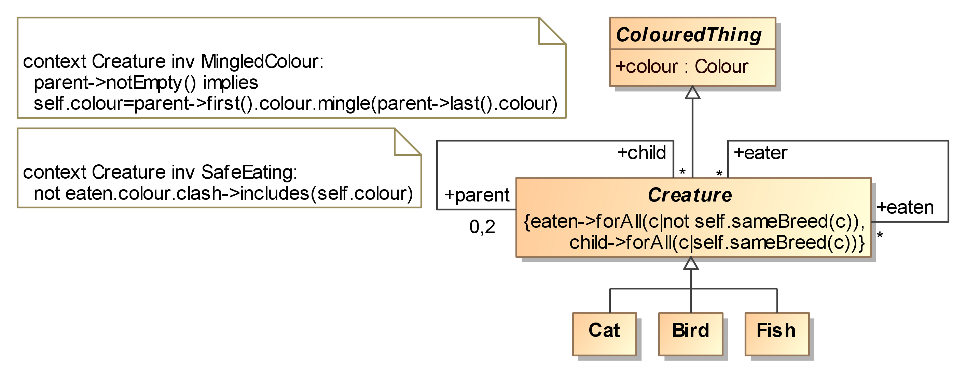
Model inheritance [7,10]

Slide 19
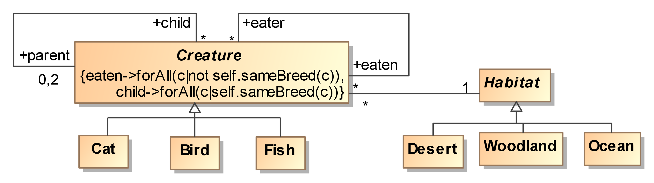
Model Extension [6]
The combined metamodel contains the “duplicate-free union” of the metamodels being combined
The user defines the elements that should be “unified” based on the correspondences between them

Slide 20
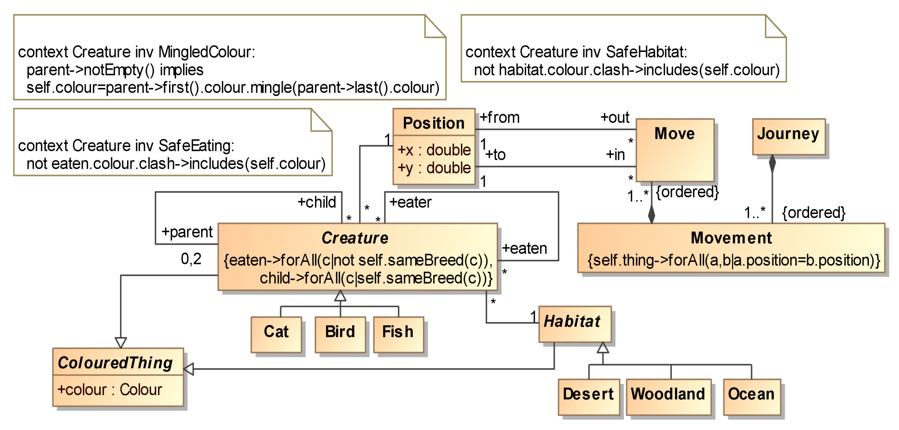
Combined model

Slide 21
Language embedding [8,9]
UML, Skala, Haskell, Maude… are typical host languages
The embedded language(s) can use the syntax of the host language, its module system, associated tools, …
The embedding is defined in terms of a mapping that defines how elements of the embedded language are represented in terms of constucts of the host language
Embedding can be used to provide (translational) semantics to a language

Slide 22
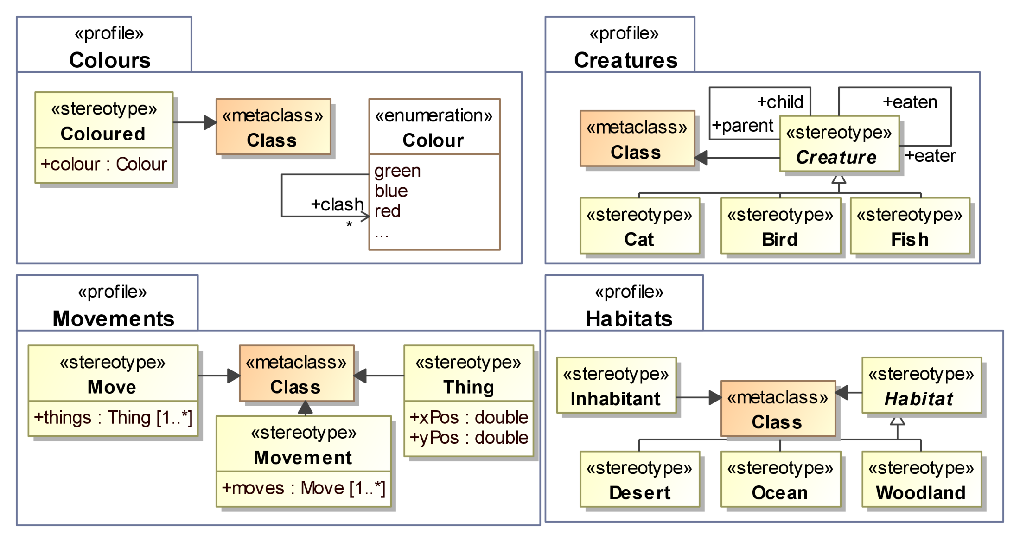
Language embedding

Slide 23
That was easy and painless, wasn’t it?
But… Does it always work?

Slide 24
Problems of language embedding
It means re-definining the embedded languages
E.g. MSCs and statecharts in UML 1
This hinders the use of their native associated tools
The concrete syntax is completely distorted
Semantics adaptations are frequent
E.g. MSCs and statecharts in UML
The relations between the view elements gets blurred
The host metamodel is complex
It does not have mechanisms for expressing correspondences
Users lose the conciseness and simplicity of DSMLs and are forced to use a complex language
Combination of embedded languages is not properly defined (e.g., SysML+MARTE?)
Users soon start making use of elements of the host language outside their viewpoint languages!

Slide 25
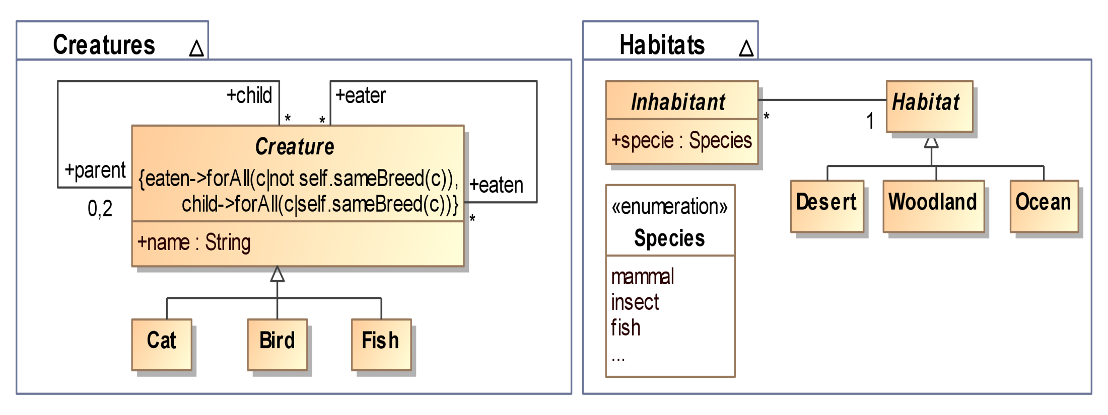
Other option: (Meta)model merge

Slide 26
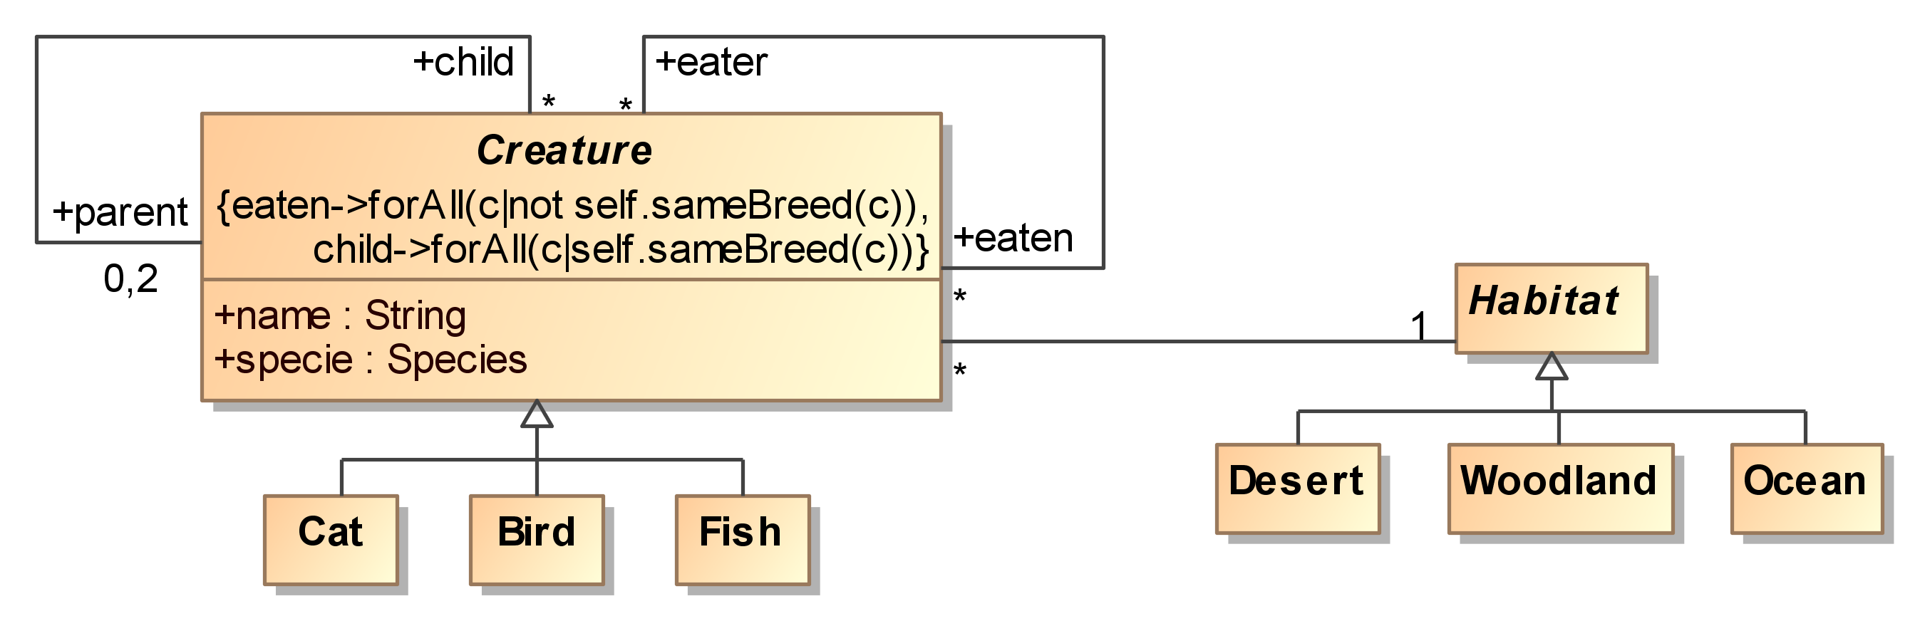
Model Merge [5,7]
An algorithm for merging models based on correspondences defined between them
The merge is again the duplicate-free union of the model elements

Slide 27
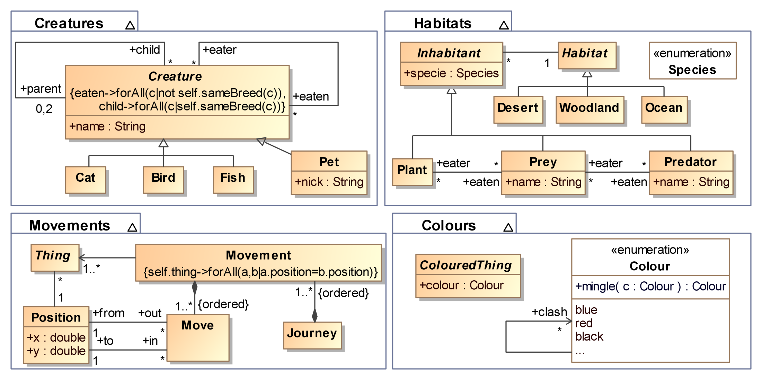
Problems of metamodel merge

Slide 28
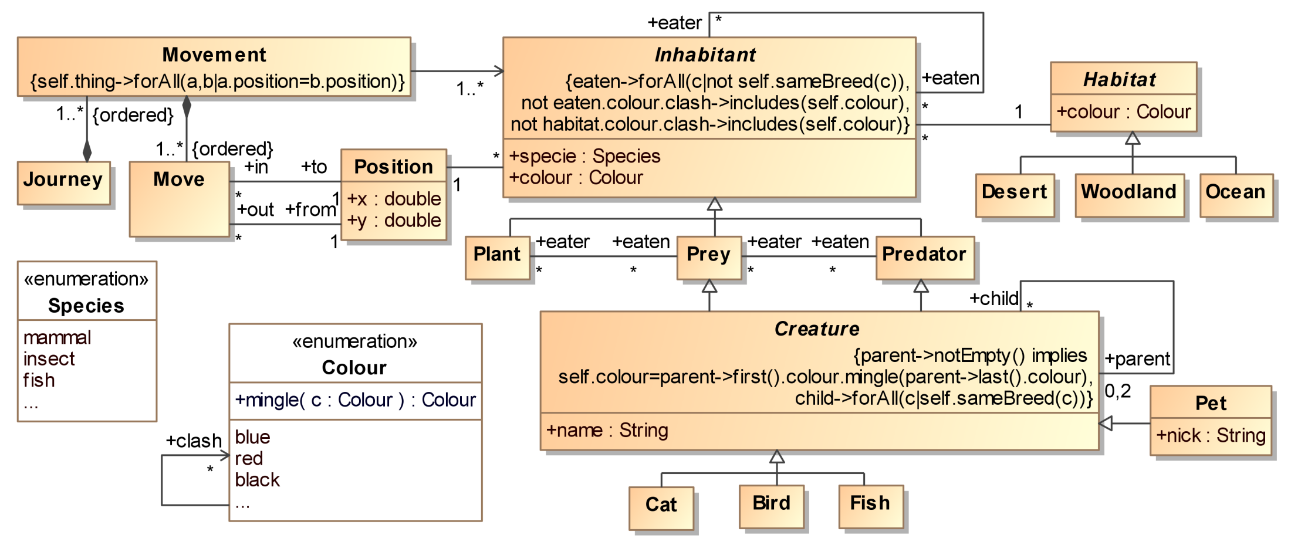
It might work…

Slide 29
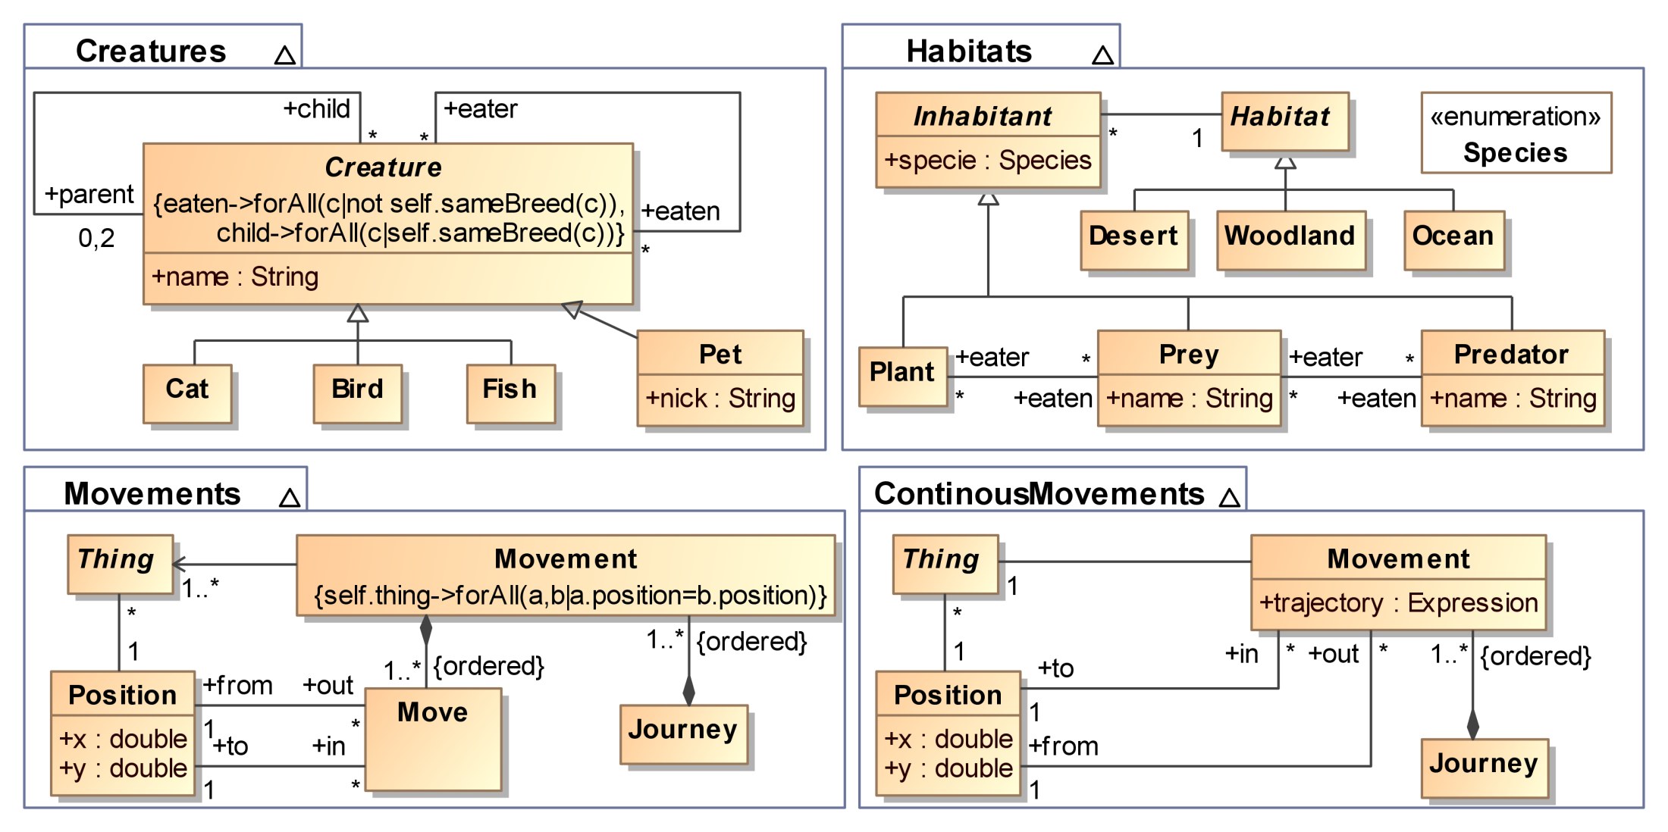
More problems of metamodel merge

Slide 30
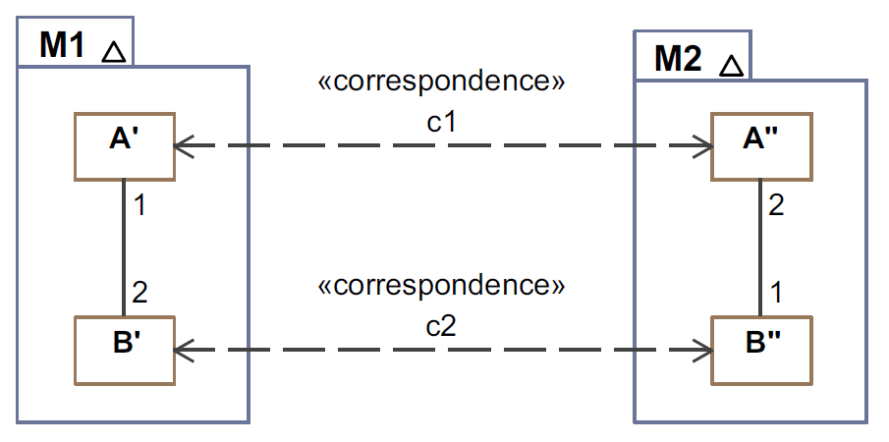
Another problem
How to merge these two metamodels?

Slide 31
And what about this?
How to merge BPMN and UML activities models?

Slide 32
And what about this?
The situation is not that simple, though…
or
and

Slide 33
A DSML combination approach based on Model Unification

Slide 34
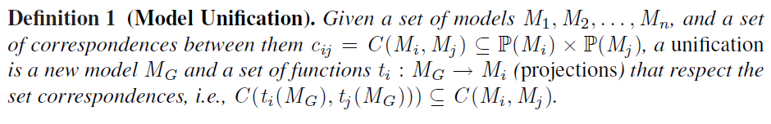
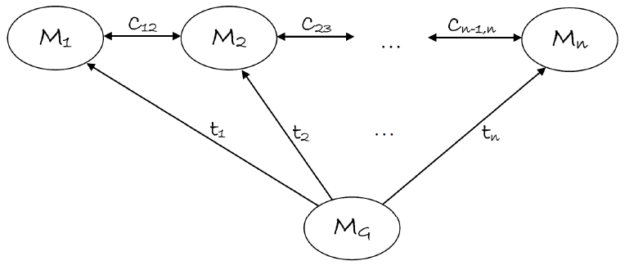
Model Unification

Slide 35
Some comments
Inspired in the original notion of Viewpoint Unification [15]
The form of unification depends on the DSMLs to be combined
The kind of projections depend on the relationship between the DSMLs and the unified language
Refinement; abstraction; equivalence; implementation; …
Viewpoint consistency is checked using the projections and the fact that they have to respect the correspondences
Model unification subsumes all previous approaches
The unified model can be developed using model inheritance, extension or merge – whenever possible
The unified model corresponds to the “least developed unification” of [5]
Projections are the inverse of mapping functions

Slide 36
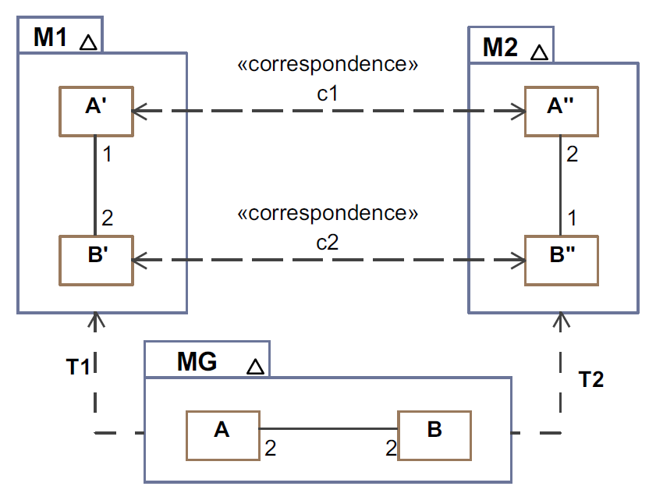
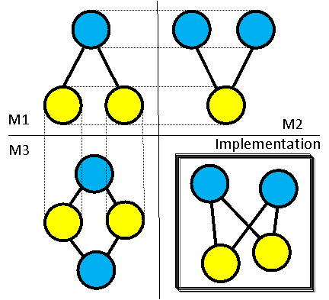

Slide 37
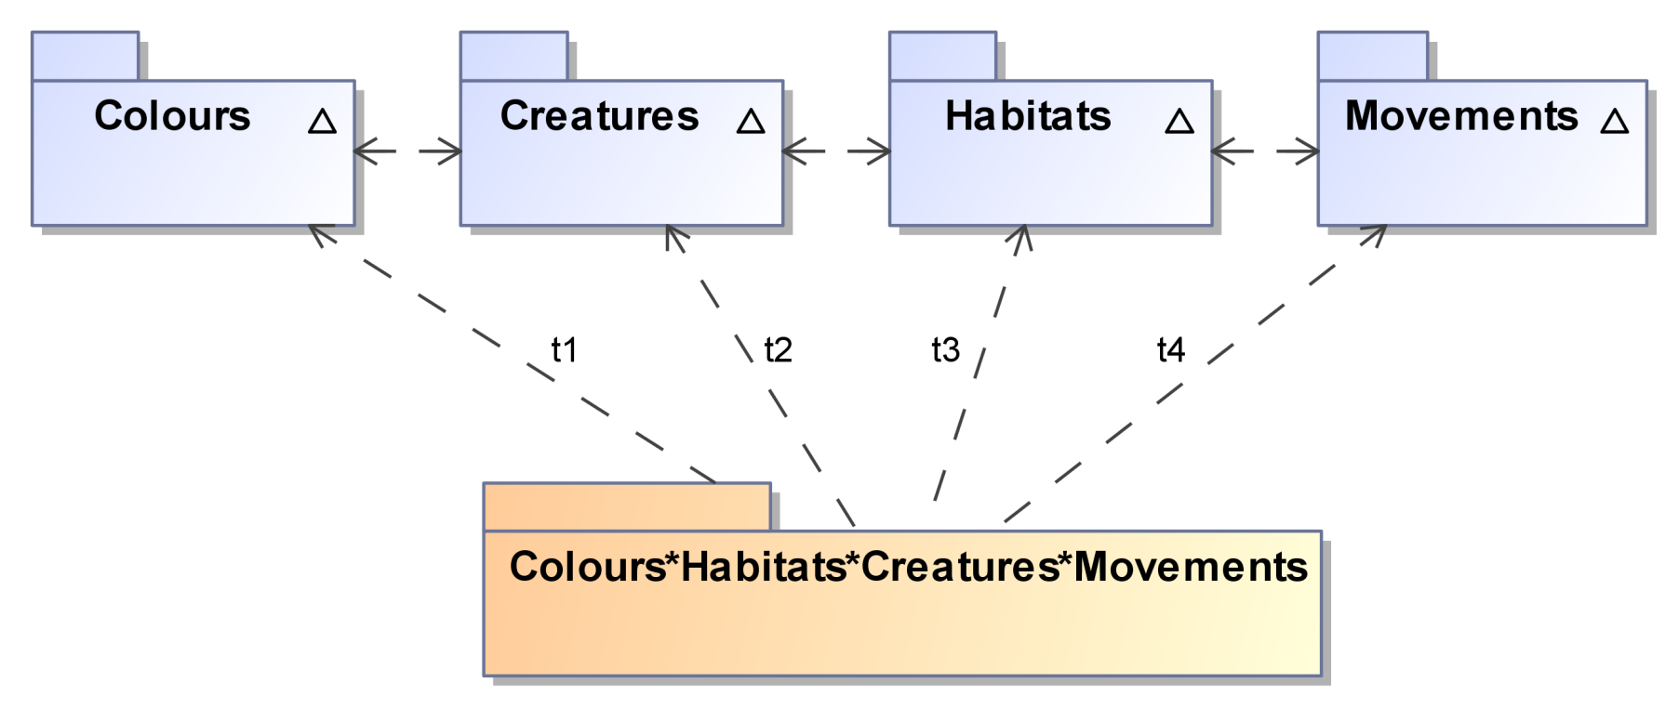
module t4;
create OUT : Movements
from IN : MG ;
…
rule inh2thing {
from i : MG!Inhabitant
to t : Movements!Thing
}
…

Slide 38
Does this always work?
Sometimes it is not possible (inconsistent views)
1
1
1
1

Slide 39
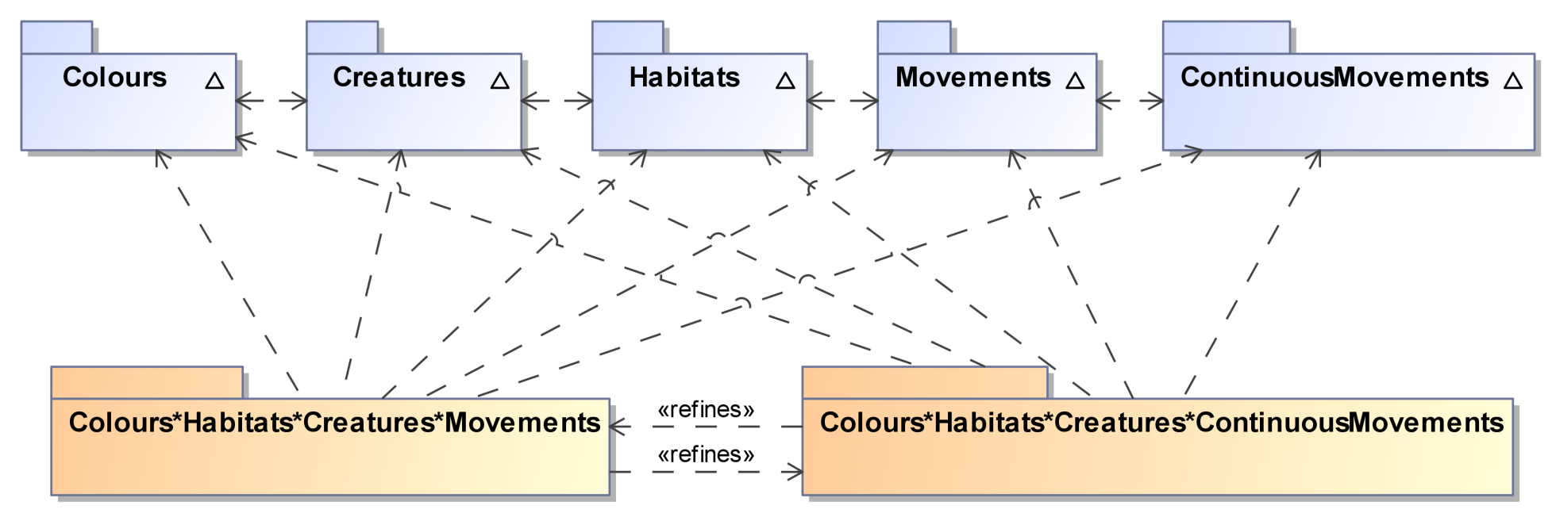
Does this always work? (II)
Sometimes there are several choices: No unique unified metamodel
Continuous refines discrete, or discrete refines continuous

Slide 40
Viewpoint analysis
From the unified metamodel and the set of projections:
The projections are mappings that provide the bridges between the unified metamodel and the views
Viewpoint analysis is automatic if projections are defined in terms of model transformations
E.g., we have defined ATL model transformations to implement the projections for the Zoological example
New views can be defined by projections (model transformations) from the unified metamodel

Slide 41
Further issues
What happens with the concrete syntax?
In our proposal users do not need to deal with the unified language…
Otherwise,
Do you super-impose icons? :-O
Do you invent yet another notation? :-(
…
What happens with the semantics?
This is tough in most approaches…
In an unification context, the semantics of the individual viewpoints and of the unified metamodel are preserved
Projections act as semantic bridges that relate the semantics

Slide 42
A typical application scenario
A user is confronted with two DSMLs to combine
The user defines the correspondences
Model weaving techniques can be useful here
Can model extension or model merge algorithms work?
If so, apply the algorithms described in [5] or [6]
The projections are just the inverse of their mappings functions
Otherwise, define a new combined language
By language embedding (if none of the issues mentioned above represent a problem for you)
Projections are the inverse of the mappings
By defining a new metamodel
Projections are defined by the user (as model transformations!)

Slide 43
Conclusions
We have discussed the different mechanisms available for DSML combination, their advantages and limitations
We propose a general framework for combining DSMLs that subsumes them, based on the concept of unification and its realization using model-driven techniques
We are applying our work in the context of Multi-Viewpoint approaches such as MDWE or RM-ODP

Slide 44
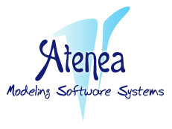


Thanks!
Acknowledgements:

